Slide 1
Animation and Input
CSCI 440 - Day Six

Slide 2
Animation
Basic Steps to Draw Something:
var vertices = [ … ];
var BufferId = gl.CreateBuffer();
gl.bindBuffer ( … , BufferId );
gl.bufferData ( …, flatten (vertices),…)
function render()
{
gl.clear (…);
gl.drawArrays (gl.TRIANGLES, 0, vertexCount);
}
Notes:
to create movement, something must change and render() must be called again.

Slide 3
Animation
To create movement:
data points must change
option one: send new data points
option two: make the vertex shader compute new points
render() must be called again
option one: call itself recursively
option two: put it on a timer

Slide 4
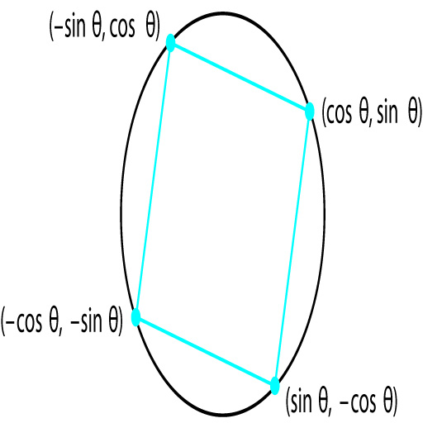
Animation - options to create movement
To change the data points:
Option 1 - inside render(): have CPU update vertices[], then call bufferData.
Option 2A - send the GPU a new angle
Option 2B - send the GPU a 4x4 matrix

Slide 5
Option 2A - send new angle
JavaScript:
var theta = 0.0;
var vertices = [ a square ];
bufferData vertices to GPU's vPosition
var thetaLocation = gl.getUniformLocation
( program, "theta" );
function render()
{
gl.clear …
theta += 0.1;
gl.uniform1f (thetaLocation, theta);
gl.drawArrays …
}
Vertex Shader:
attribute vec4 vPosition;
uniform float theta;
void main()
{
gl_Position.x = -sin(theta) * vPosition.x + …
gl_Position.y = sin(theta) * vPosition.y + …
gl_Position.z = 0.0;
gl_Position.w = 1.0;
}

Slide 6
Option 2B - send a new matrix
JavaScript:
var vertices = [ a square ];
bufferData vertices to GPU's vPosition
modelMatrixLocation = gl.getUniformLocation ( program, "modelMatrix" );
function render()
{
gl.clear …
amount += 0.01;
myMatrix = rotate (amount, [0,0,1]);
gl.uniformMatrix4fv (modelMatrixLocation, false, flatten(myMatrix) );
gl.drawArrays ( … );
}
Vertex Shader:
attribute vec4 vPosition;
uniform mat4 modelMatrix;
void main()
{
gl_Position = modelMatrix * vPosition;
}
How this works is next week

Slide 7
Animation
To create movement:
data points must change
option one: send new data points
option two: make the vertex shader compute new points
render() must be called again
option one: call itself recursively
option two: put it on a timer

Slide 8
Animation - repeating render()
Manually set a timer:
setInterval ( render, 33 ); // 30 frames/sec
Make render() recursive:
render()
{
...
render ();
}
Update as fast as possible when visible:
render()
{
…
requestAnimFrame ( render );
}

Slide 9
Input - vocabulary
Physical Input Device - characterized by its mechanics
e.g. a mouse
Logical Input Device - characterized by what the device does
e.g. an (X,Y) location or a menu choice
In 99.99% of applications, you probably want to avoid programming at the physical device level
tedious code
non-portable code
see textbook section 3.4

Slide 10
Input Modes
Request Mode
the device returns a value when device is triggered
e.g. cin >> value;
Sample Mode
input is immediate
e.g. periodically poll the location of the mouse
Event Mode
user creates events that trigger callback functions
e.g. nearly every server
e.g. nearly every GUI
see textbook section 3.4

Slide 11

Traditional Logical Input Devices
String
e.g. keyboard input
Locator
e.g. an X,Y location from a mouse
Pick
e.g. an item on the screen that was selected
Choice
e.g. one of a discrete number of options, menu
Valuator
e.g. a slide bar
Stroke
e.g. an array of locations
Gesture
e.g. two finger pinch
see textbook section 3.4

Slide 12
Input with WebGL
WebGL has No direct support for input
OpenGL discontinued support for input
makes WebGL code more portable
JavaScript
event driven
we can tie callback functions to HTML buttons, slide bars, menus, text boxes, etc.

Slide 13
JavaScript's Logical Input Devices
String
HTML text box
Locator
X,Y location connected to a click event
Pick
see next slide
Choice
HTML menu
Valuator
HTML slidebar
Stroke
store X,Y locations of a series of click events

Slide 14
Picking with JavaScript
Make a "hit list" of which objects remained after clipping
transform the event's X,Y screen coordinates into world coordinates
check each un-clipped object to determine which one was near the selected location
this is difficult because we usually only know the modelling coordinates of objects, not where the objects were transformed

Slide 15
Suppose the variable "amount" is set by some buttons or a slide bar. How does our render() code need to change?
function render()
{
gl.clear …
myMatrix = rotate (amount, [0,0,1]);
gl.uniformMatrix4fv(…,flatten(myMatrix));
gl.drawArrays ( … );
requestAnimFrame ( render );
}

Slide 16

Next class
Lots of JavaScript code
buttons
menus
slide bars

